Slide 1
Health Care Breakout Session 1: ML from the Clinician’s Perspective
Matt Engelhard
Notes:
Part 1: What has machine learning done?
Part 2: What is machine learning?
Part 2: A focus on evaluation (throughout these sessions)

Slide 2
These sessions will:
Attempt to demystify machine learning through presentation and discussion
Highlight exciting applications to inspire ideas
Emphasize essential concepts needed to collaborate with ML practitioners
Notes:
Note that the remaining sessions will emphasize a specific paper

Slide 3
These sessions will not:
Delve further into mathematical details
Provide more hands-on training
Emphasize clinical concepts
Notes:
No hands on training, however I do want to point out that research can be done with code that is very similar to what you’re learning.

Slide 4
Today:
A few exciting medical applications of ML
How does ML relates to more familiar statistical approaches?
Essentials of model evaluation
Notes:
No hands on training, however I do want to point out that research can be done with code that is very similar to what you’re learning.

Slide 5
Machine learning in Medicine
A few applications of

Slide 6
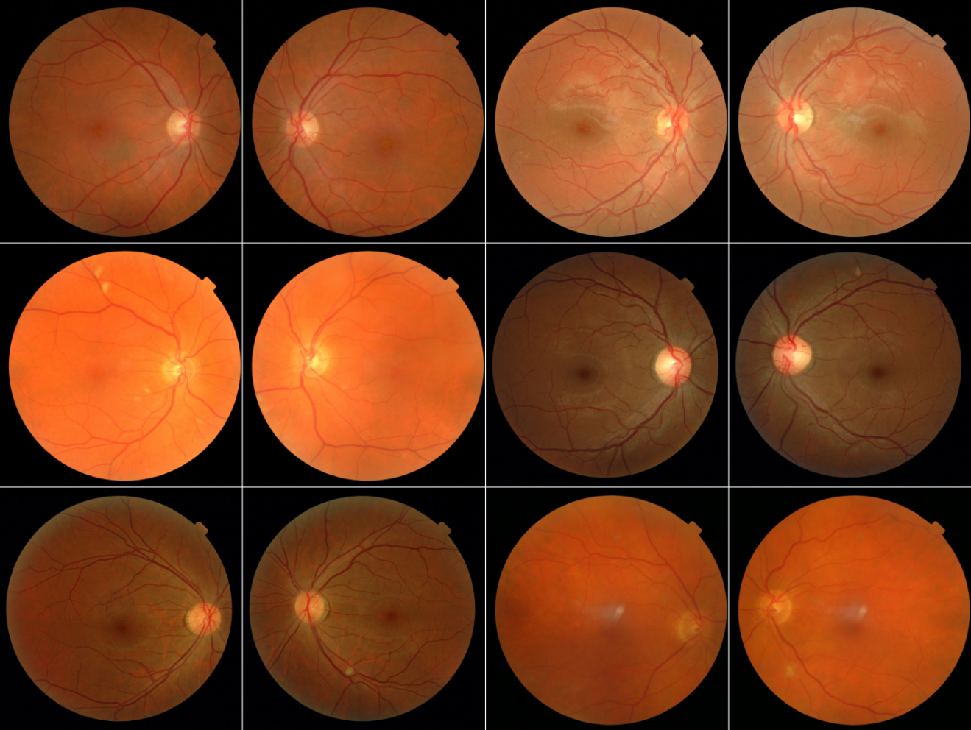
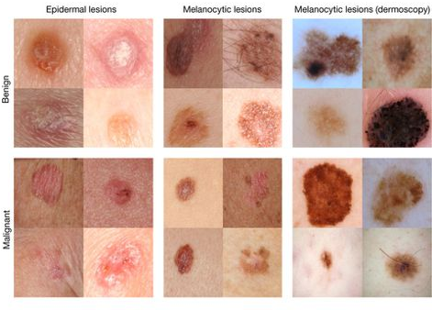
Medical Imaging
Improved Automated Detection of Diabetic Retinopathy
Invest. Ophthalmol. Vis. Sci.. 2016;57(13):5200-5206. doi:10.1167/iovs.16-19964
Dermatologist-level classification of skin cancer
Nature volume 542, pages 115–118 (02 February 2017)
Notes:
Paper at right will be discussed tomorrow
Both papers use CNNs, which is tomorrow’s topic of the day.
These are some of the most high-profile cases
A common view is that imaging will be the first to be disrupted.

Slide 7
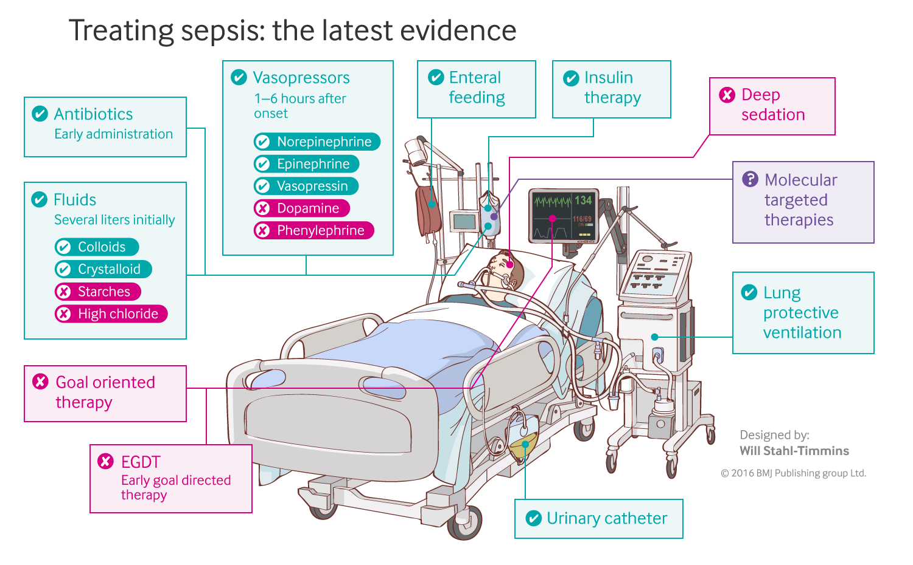
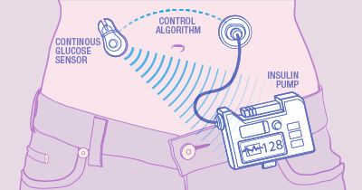
Sequential Decision-Making
Closed-loop blood glucose control
(“artificial pancreas”)
Fluid and vasopressor administration
for sepsis treatment
https://www.mayo.edu/research/labs/artificial-pancreas/overview
Gotts JE, Matthay MA. Sepsis: pathophysiology and clinical management. bmj. 2016 May 23;353(i1585).
Notes:
Other high profile examples:
Weaning of mechanical ventilation
Heparin dosing
Will see an explosion in this area

Slide 8
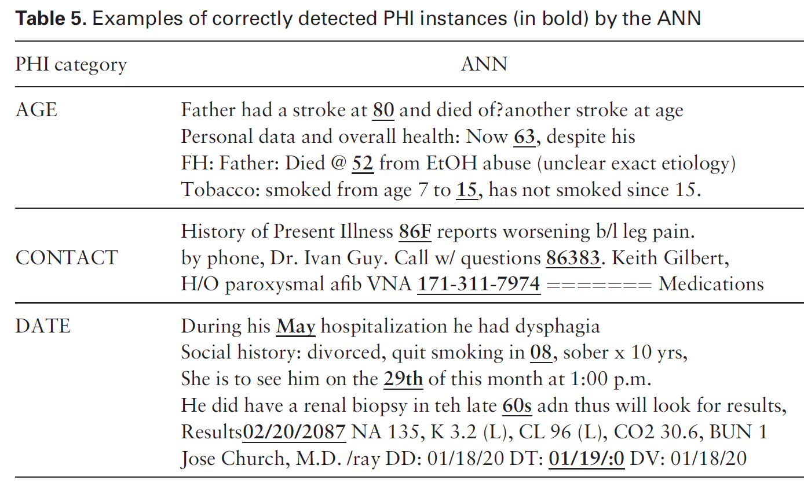
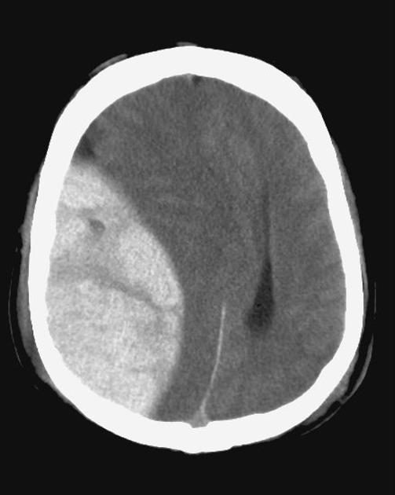
Natural Language Processing
Classification of radiology reports using neural attention models, IJCNN 2017
De-identification of patient notes with recurrent neural networks
JAMIA 24(3), 2017, 596–606
Mass effect from extradural hemorrhage
https://radiopaedia.org

Slide 9
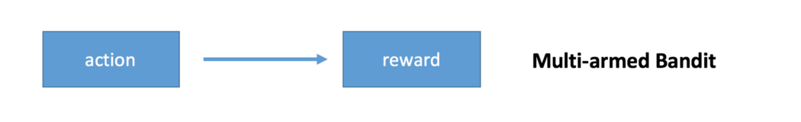
Adaptive Trial Design
“Despite this apparent near-perfect fit between a real-world problem and a mathematical theory, the multi-armed bandit problem has yet to be applied to an actual clinical trial.” (Villar, Bowden and Wason, 2015)
“An explicit assumption is the goal to treat patients effectively, in the trial as well as out. That is controversial” (Stangl, Inoue and Irony, 2012)
(a simplified case of reinforcement learning)

Slide 10
Transformative or Over-Hyped?
“Machine learning has become ubiquitous and indispensable for solving complex problems in most sciences. The same methods will open up vast new possibilities in medicine.” (Obermeyer and Emanuel, NEJM, 2016)
“With machine learning situated at the peak of inflated expectations, we can soften a subsequent crash into a ‘trough of disillusionment’ by fostering a stronger appreciation of the technology’s capabilities and limitations.” (Chen and Asch, NEJM, 2017)
Notes:
Obermeyer is a great article on ML vs what came before
In my view, it’s a little of both. There’s a lot of vague hype, e.g. IBM Watson, and high expectations, but really, this space has only begun to be explored.
Any thoughts anyone wanted to share about either paper?
Now these are both fairly optimistic…
Some are already falling into the trough of disillusionment… had a person say they “stop reading” grant proposals that mention ML without giving details.

Slide 11
What is Machine Learning?
From a clinician’s perspective,

Slide 12
Q: What is Machine Learning?
Increasing Hype
“cognitive computing”
“artificial intelligence”
“predictive analytics”
“curve fitting”
“better stepwise regression”
“statistics for programmers”
Notes:
A3: Judea Pearl
A4: not hype – probably too limited!

Slide 13
Q: What is Machine Learning?
“ML is an algorithmic field that blends ideas from statistics, computer science and many other disciplines to design algorithms that process data, make predictions and help make decisions” – M. I. Jordan
Notes:
Other fields:
Optimization and operations research
Engineering, e.g. control theory
Neuroscience (day 2)
Cognitive science
linguistics

Slide 14
Q: What is Machine Learning?
“ML is an algorithmic field that blends ideas from statistics, computer science and many other disciplines to design algorithms that process data, make predictions and help make decisions” – M. I. Jordan
Notes:
Other fields:
Optimization and operations research
Engineering, e.g. control theory
Neuroscience (day 2)
Cognitive science
linguistics

Slide 15
Q: What is Machine Learning?
“ML is an algorithmic field that blends ideas from statistics, computer science and many other disciplines to design algorithms that process data, make predictions and help make decisions” – M. I. Jordan
Notes:
Other fields:
Optimization and operations research
Engineering, e.g. control theory
Neuroscience (day 2)
Cognitive science
linguistics

Slide 16
Q: What is Machine Learning?
“ML is an algorithmic field that blends ideas from statistics, computer science and many other disciplines to design algorithms that process data, make predictions and help make decisions” – M. I. Jordan
Notes:
Other fields:
Optimization and operations research
Engineering, e.g. control theory
Neuroscience (day 2)
Cognitive science
linguistics

Slide 17
Both ML and statistics:
are based in math and probability
fit mathematical models to data
Compared to statisticians, ML practitioners tend to:
be willing to use complicated models
emphasize prediction over explanation
focus more on model architectures and less on feature crafting and selection
Neither field can squeeze information that doesn’t exist out of a dataset!
“Statistical Learning”
Machine
Learning
Statistics
Notes:
Extremely closely related fields; in fact the overlap probably isn’t large enough
Success of machine learning tied to the success of big data.
Statistics is changing too.
Note: prediction is not longitudinal – used in a statistical sense

Slide 18
So, clinical/scientific judgement and intuition are critical to successful collaboration.
Both ML and statistics:
are based in math and probability
fit mathematical models to data
Compared to statisticians, ML practitioners tend to:
be willing to use complicated models
emphasize prediction over explanation
focus more on model architectures and less on feature crafting and selection
Neither field can squeeze information that doesn’t exist out of a dataset!
Traditional Hypothesis:
measure M predicts outcome O
ML Hypothesis:
data D predicts outcome O

Slide 19
What’s different about ML?
1) Willingness to use complicated models

Slide 20

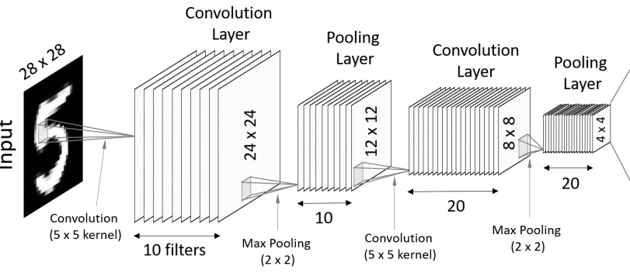
Willing to use complicated models
Multilayer Perceptron
Deep Convolutional Neural Network

Slide 21
Why Use Complicated Models?
Logistic regression can only split data by linear trends
So, cannot separate the two classes here ->
Notes:
This one we talked about quite a bit in this morning’s lecture.
Much greater flexibility.
So, let’s say these points represent EKG features, the red points are +MI, and the blue points are –MI.
If you try to use a linear decision boundary, you’re not going to do very well!

Slide 22
Why Use Complicated Models?
Can only split data by linear trends
Best effort at separating them ->

Slide 23
ML models are (generally) more flexible
A nonlinear decision boundary separates these classes much more effectively ->
Notes:
This applies to regression, too: many things involve nonlinear interactions.

Slide 24
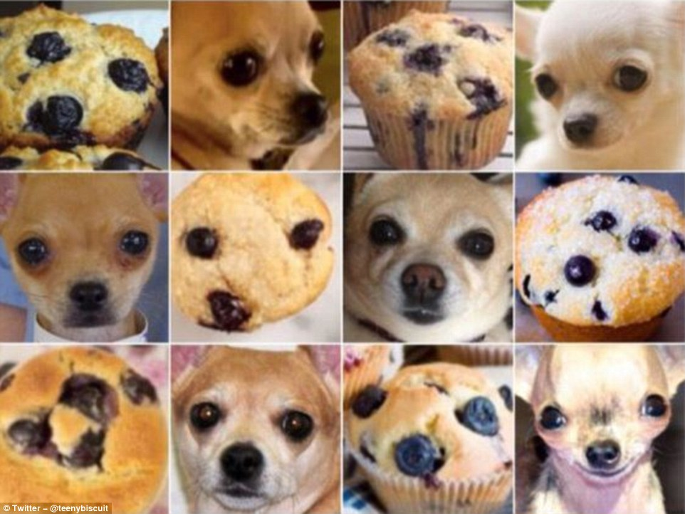
Decision boundary: dog vs muffin

Slide 25
Decision boundary: benign vs malignant

Slide 26
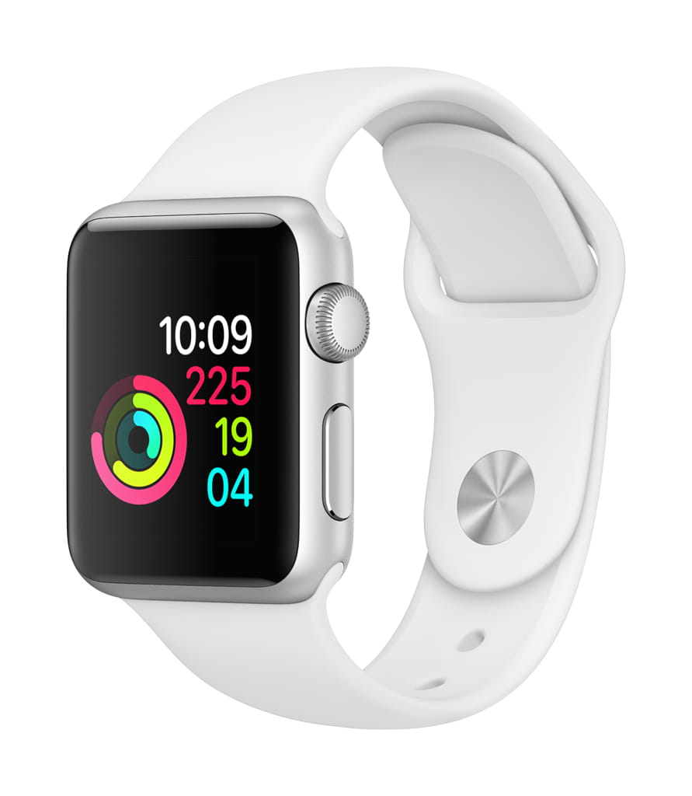


Complicated models like lots of data
Notes:
Emphasize that this is arguably the more fundamental shift that’s happening (in both stats and ML): the huge amount of data that’s now collected, including in health.

Slide 27
What’s different about ML?
2) Emphasis on prediction over explanation

Slide 28
EXPLANATION
Statistical significance testing
Null hypothesis versus alternative hypothesis
p-values
Goodness of fit measures
R^2 and adjusted R^2
Likelihood ratios and information criteria
PREDICTION
Quantify error on a separate test set (i.e. out-of-sample)
Classification error: AUC and accuracy
Regression error: mean squared error, mean absolute error
ML
Notes:
Note that prediction gets us away from the p-value nonsense.
Sometimes we use p-values to determine whether differences between models are statistically significant. That’s about it.

Slide 29
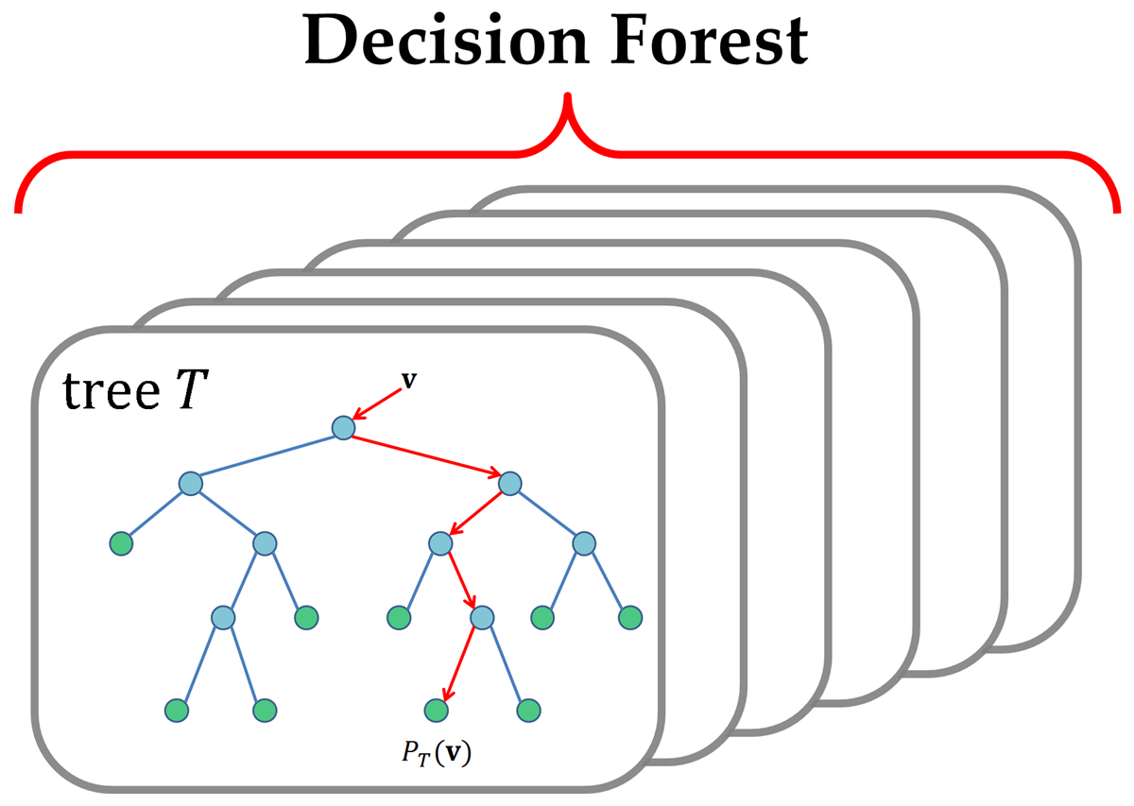
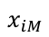
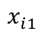
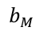
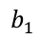
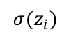
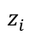
Advantages of a Predictive Approach: 1) Any two models can be compared
Logistic Regression
$${σ(z}_{i})$$
$$z_{i}$$
$$b_{1}$$
$$b_{M}$$
$$x_{i1}$$
$$x_{iM}$$
Notes:
Goodness of fit are typically designed for specific models, likelihood ratio tests usually compare nested models, etc.

Slide 30
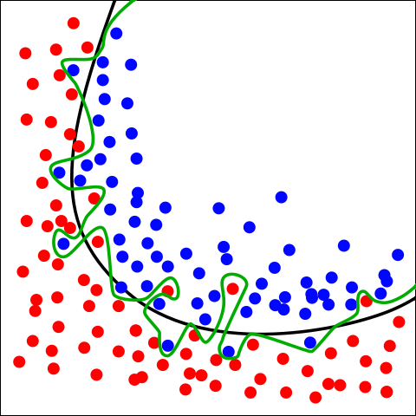
Advantages of a Predictive Approach: 2) Graceful solution to overfitting and bias/variance tradeoff
Green boundary:
No errors, but likely represents overfitting
Using a different training subset would probably result in a very different boundary
Black boundary:
Slightly more errors, but much less complex
Instead of explicitly penalizing model complexity, we let the test set speak for itself
By Chabacano - Own work, CC BY-SA 4.0, https://commons.wikimedia.org/w/index.php?curid=3610704
Notes:
Willingness to embrace complex models → need this better approach to overfitting.

Slide 31
What’s different about ML?
3) Emphasize model crafting over feature crafting

Slide 32
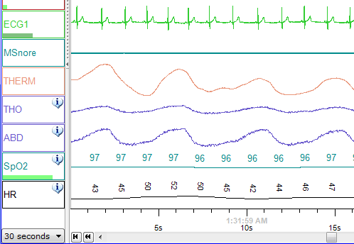
Sleep -> outcomes by feature crafting
Raw Data
Handcrafted
Features
Total sleep time
Sleep Efficiency
Sleep Onset Latency
Intraday variability
Interday stability
Sleep reliability Index

Slide 33
Choose a method to select features
Total sleep time
y, associated outcome 0/1
x, data/features for a subject
e.g. stepwise regression with forward selection
(familiar example, but NOT a good approach)
Notes:
Aside – this is NOT a good feature selection method.
Greedy selection, known to produce unstable results
Just using for familiarity.

Slide 34
Sleep -> outcomes by model crafting
Multilayer Model
Raw Data
Early layers can be viewed as feature extractors
Notes:
Another place where clinical and scientific judgment come into play! Knowledge can inspire model architecture.

Slide 35
Prediction-Based Evaluation
Flexible
Models
Learned
Features

Slide 36
ML is much broader than classification
Supervised Learning
Reinforcement Learning
Classification
And more…
Unsupervised Learning
LR and MLP
Classifiers

Slide 37
Model EValuation
Essentials of

Slide 38
Model Evaluation
Three recurring topics:
Preparing the data for evaluation
training, validation, test sets
cross-validation
Evaluation measures
classification
regression
Interpreting the model
Notes:
We will come back to these with each paper. This shows the general case, but evaluation is a little different for each model.

Slide 39
Preparing the data for evaluation
y, associated label 0/1
x, data/features for a subject
Recall that the data consist of many (x,y) pairs

Slide 40
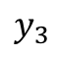
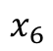
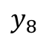
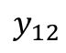
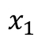
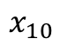
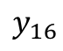
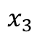
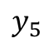
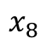
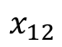
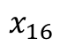
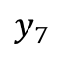
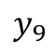
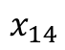
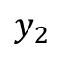
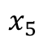
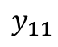
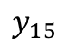
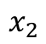
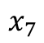
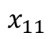
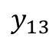
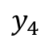
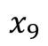
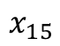
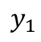
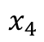
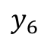
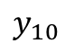
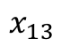

Training, Validation, and Test Sets
$$x_{1}$$
$$y_{1}$$
$$x_{2}$$
$$y_{2}$$
$$x_{3}$$
$$y_{3}$$
$$x_{4}$$
$$y_{4}$$
$$x_{5}$$
$$y_{5}$$
train the model
$$x_{6}$$
$$y_{6}$$
training set
$$x_{7}$$
$$y_{7}$$
$$x_{8}$$
$$y_{8}$$
$$x_{9}$$
$$y_{9}$$
$$x_{10}$$
$$y_{10}$$
$$x_{11}$$
$$y_{11}$$
choose between models
decide when to stop training
$$x_{12}$$
$$y_{12}$$
$$x_{13}$$
$$y_{13}$$
validation set
$$x_{14}$$
$$y_{14}$$
evaluate performance
$$x_{15}$$
$$y_{15}$$
test set
$$x_{16}$$
$$y_{16}$$
Notes:
Training set is used to fit model
Validation set is used to select models and/or hyperparameters (give examples)
Test set is used to test performance
Partition by participant
“train the model” –minimize some measure of loss over these data, typically via stochastic gradient descent

Slide 41
Training, Validation, and Test Sets
This can be more nuanced than it might seem, and is a common source of methodological errors!
In general, it is good practice to assign the data at random.
However:
Multiple records from the same person (e.g. images of skin lesions) should (usually) be assigned to the same set
Longitudinal prediction tasks might use the most recent data as the test set
The assignment scheme may depend on specifics of the application and claim of generalization.
Notes:
Essentially, multiple records from a single person is “clustered data”. If you split them across sets, you are still overfitting.
-- could be a figure here, or could use the board.

Slide 42
Cross-Validation (when you don’t have data to spare…)
Divide dataset into k equal-sized subsets (i.e. “folds”)
Train model on all subsets but one, then test on the remaining subset
Repeat (2) k times such that all subsets have been used for testing
If a validation set is needed, we select a portion of the current training set as a validation set

Slide 43
































Cross-Validation (when you don’t have data to spare…)
$$x_{1}$$
$$y_{1}$$
training set
$$x_{2}$$
$$y_{2}$$
$$x_{3}$$
$$y_{3}$$
test set
$$x_{4}$$
$$y_{4}$$
$$x_{5}$$
$$y_{5}$$
$$x_{6}$$
$$y_{6}$$
$$x_{7}$$
$$y_{7}$$
$$x_{8}$$
$$y_{8}$$
$$x_{9}$$
$$y_{9}$$
$$x_{10}$$
$$y_{10}$$
$$x_{11}$$
$$y_{11}$$
$$x_{12}$$
$$y_{12}$$
$$x_{13}$$
$$y_{13}$$
$$x_{14}$$
$$y_{14}$$
$$x_{15}$$
$$y_{15}$$
$$x_{16}$$
$$y_{16}$$

Slide 44
Nested Cross-Validation (when you don’t have data to spare…)
$$x_{1}$$
$$y_{1}$$
training set
$$x_{2}$$
$$y_{2}$$
validation set
$$x_{3}$$
$$y_{3}$$
test set
$$x_{4}$$
$$y_{4}$$
$$x_{5}$$
$$y_{5}$$
$$x_{6}$$
$$y_{6}$$
$$x_{7}$$
$$y_{7}$$
$$x_{8}$$
$$y_{8}$$
$$x_{9}$$
$$y_{9}$$
$$x_{10}$$
$$y_{10}$$
$$x_{11}$$
$$y_{11}$$
$$x_{12}$$
$$y_{12}$$
for each test group, apply the same strategy to the validation set…
$$x_{13}$$
$$y_{13}$$
$$x_{14}$$
$$y_{14}$$
$$x_{15}$$
$$y_{15}$$
$$x_{16}$$
$$y_{16}$$
Notes:
Note that this can require a lot of runs

Slide 45
Evaluation Measures: Classification
 | Condition Positive | Condition Negative
Prediction Positive | True Positive | False Positive
Prediction Negative | False Negative | True Negative

Slide 46
Confusion Matrix (>2 classes)
 | Condition 1 | Condition 2 | … | Condition N
Prediction 1 | Correct | Incorrect | … | Incorrect
Prediction 2 | Incorrect | Correct |  | Incorrect
… | … |  |  | Incorrect
Prediction N | Incorrect | Incorrect | Incorrect | Correct
…

Slide 47



Evaluation Measures: Classification
Sensitivity, or True Positive Rate:
Specificity, or (1 – False Positive Rate):
Accuracy:
 | Condition Positive | Condition Negative
Prediction Positive | True Positive | False Positive
Prediction Negative | False Negative | True Negative
$$\frac{true positives}{all condition positives}$$
$$\frac{true negatives}{all condition negatives}$$
$$\frac{true positives+true negatives}{total cases}$$

Slide 48




Probabilistic Classification
With a probabilistic classifier, we can explicitly balance sensitivity vs specificity
$p\left(y_{i}=1 | x_{i}\right)=σ(z_{i}$)
classification threshold
$σ(z_{i}$)
A low threshold favors sensitivity, because more points are classified as condition positive (i.e. 1s)

Slide 49
Probabilistic Classification
With a probabilistic classifier, we can explicitly balance sensitivity vs specificity
$p\left(y_{i}=1 | x_{i}\right)=σ(z_{i}$)
classification threshold
$σ(z_{i}$)
A high threshold favors specificity, because more points are classified as condition negative (i.e. 0s)

Slide 50




Evaluation Measures: Classification
Receiver Operating Characteristic (ROC) Curve
Sensitivity/Specificity Curve
Sensitivity, or True Positive Rate:
Specificity, or (1 – False Positive Rate):
Accuracy:
$$\frac{true positives}{all condition positives}$$
Sensitivity
True Positive Rate
Specificity
1 – False Positive Rate
$$\frac{true negatives}{all condition negatives}$$
$$\frac{true positives+true negatives}{total cases}$$
0 1
1 – Specificity
False Positive Rate
Sensitivity
True Positive Rate

Slide 51

ROC Curve Visualized
AUC:
Area Under the (ROC) Curve
AUC = 1:
Perfect classification
AUC = 0.5:
No better than chance
http://arogozhnikov.github.io/2015/10/05/roc-curve.html

Slide 52





Evaluation Measures: Regression
$$e_{i}=\left|y_{i}−{\hat{y}}_{i}\right|$$
e₈
e₁₀
e₉
$$Mean square error (MSE)=\frac{1}{n}\sum_{i=1}^{n}{e_{i}^{2}}$$
e₇
e₄
e₅
e₆
e₃
e₁
$$Mean absolute error=\frac{1}{n}\sum_{i=1}^{n}{e_{i}}$$
e₂
$$Normalized MSE=\frac{MSE}{Var(Y)}$$
Notes:
Root mean square error, normalized mean square error, etc, but these are the essentials
Other ways to measure distance between the prediction and the truth that might be appropriate for specific applications
Note that Normalized MSE is 1-R^2

Slide 53
Evaluation Measures
These are the basics, but many cases are not straightforward.
evaluate a decision-making policy (e.g. blood glucose management)
evaluate event-time predictions for a repeating event (e.g. smoking)
evaluate the quality of synthesized data

Slide 54
Interpretability: Model Coefficients
Multilayer Perceptron
Logistic Regression
$${σ(z}_{i})$$
$$z_{i}$$
$$b_{1}$$
$$b_{M}$$
$$x_{i1}$$
$$x_{iM}$$
Notes:
Argue that model coefficients tend to be overinterpreted, not stable, misleading
Often two models with very different mechanistic interpretations will perform equally well.
Point to Yarkoni et al.

Slide 55

Interpretability: Feature Visualization
From Olah, et al., "Feature Visualization", Distill, 2017.

Slide 56
Subsequent sessions will:
Present and discuss a recent medical application of the day’s topic
Emphasize specific methodological details important when evaluating the work
Briefly survey related applications to inspire research ideas

Slide 57
Thank you!
Questions or ideas? Please contact me at m.engelhard@duke.edu

